Slide 1
MASCS VIRS Data Access Using Quickmap
Noam Izenberg for the MASCS team
JHU/APL
noam.izenberg@jhuapl.edu

Slide 3
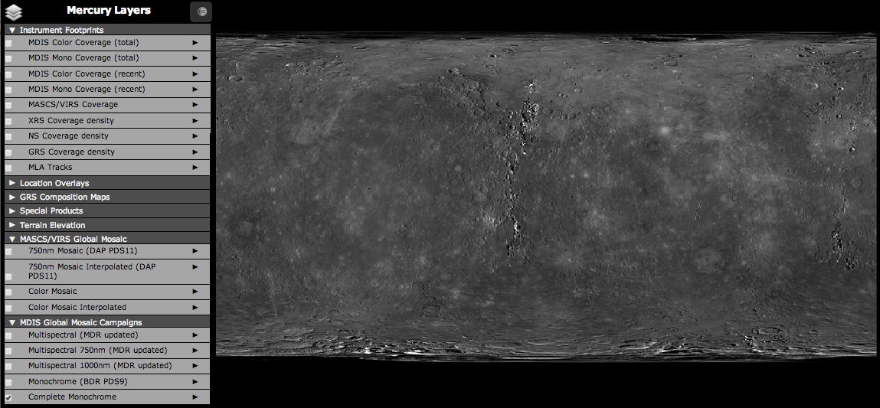
Global Overview I
MDIS basemap

Slide 4
Global Overview II
VIRS Footprint map

Slide 5
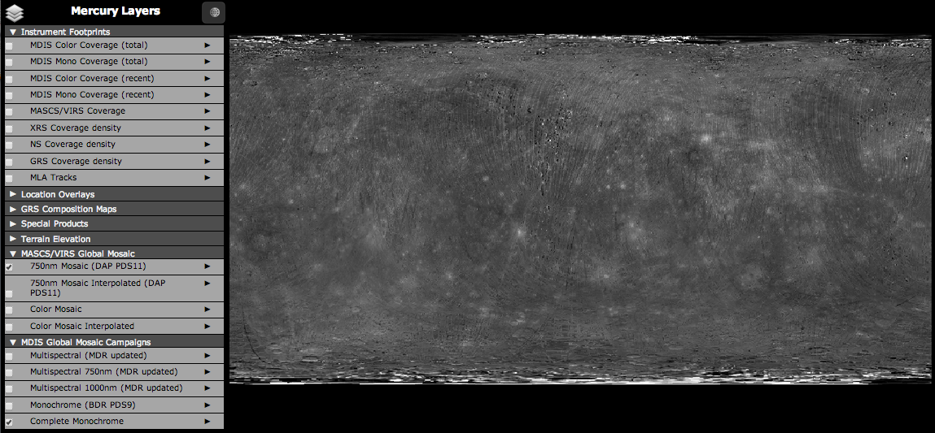
Global Overview III
VIRS 750nm Mosaic (DAP PDS11)

Slide 6
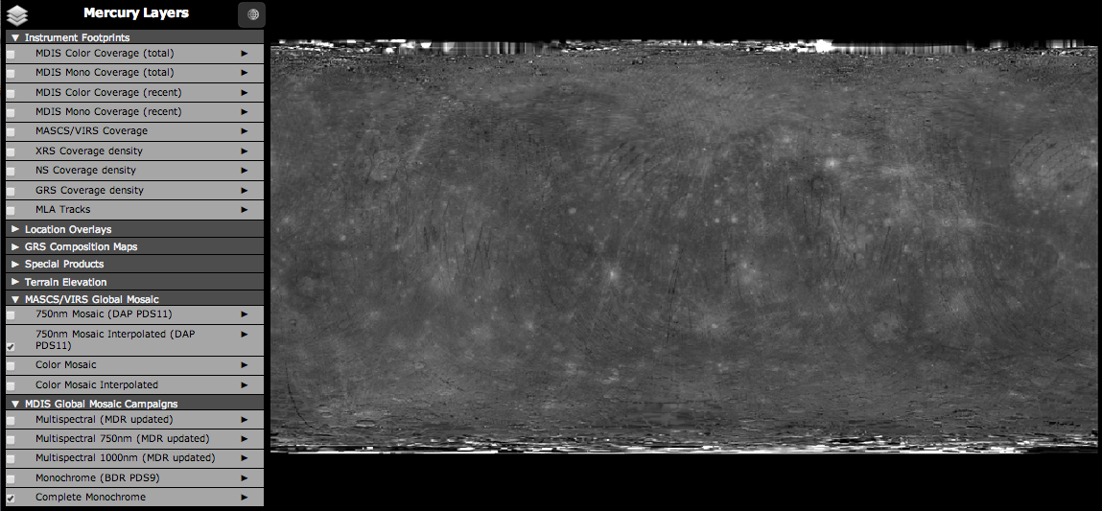
Global Overview IV
VIRS 750nm Interpolated Mosaic (DAP PDS11)

Slide 7
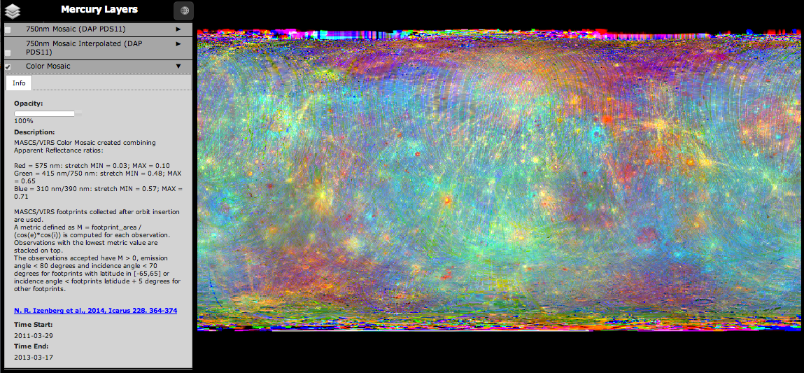
Global Overview V
Red = 575nm Reflectance
Green = 415 nm / 750 nm
Blue = 310 nm / 390 nm
VIRS Color Mosaic

Slide 8
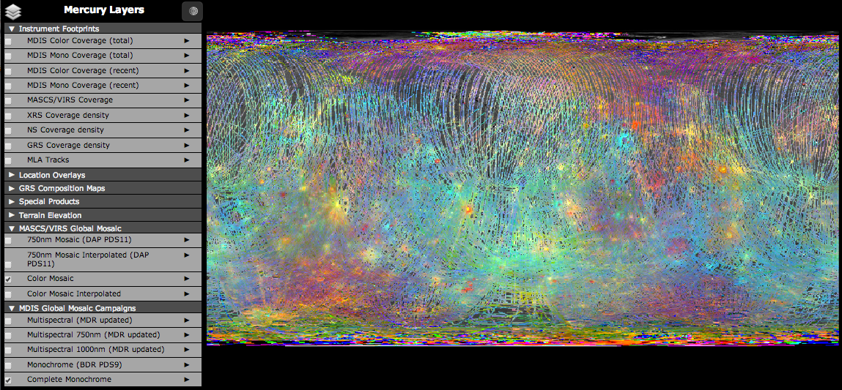
Global Overview VI
VIRS Interpolated Color Mosaic

Slide 9
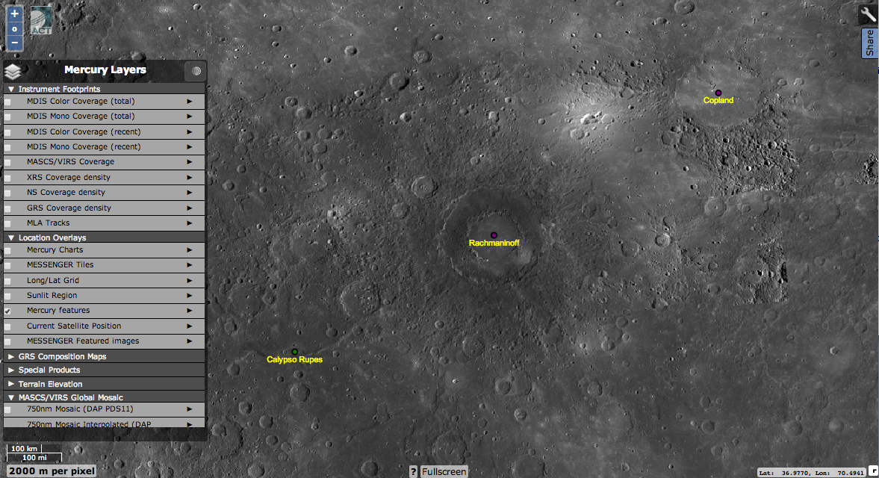
Regional I
MDIS basemap

Slide 10
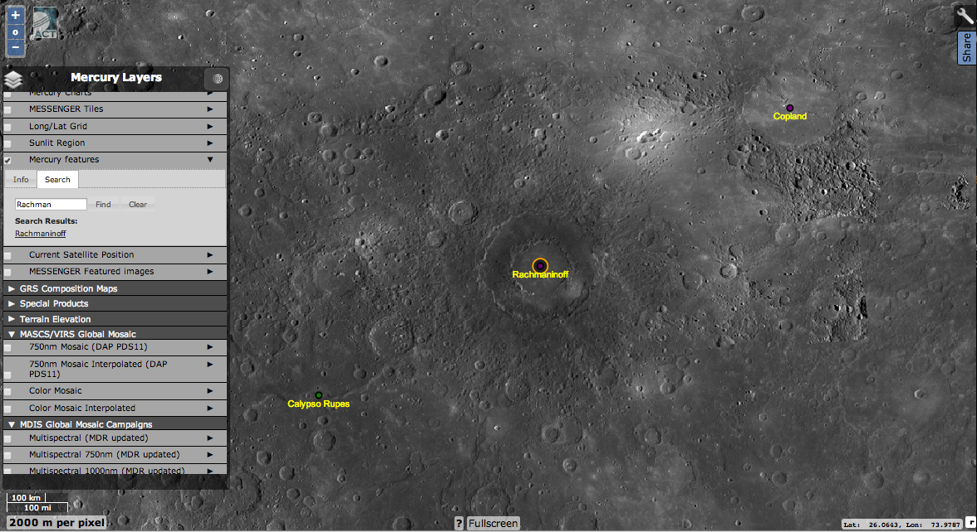
Regional Ib
Search by feature name

Slide 11
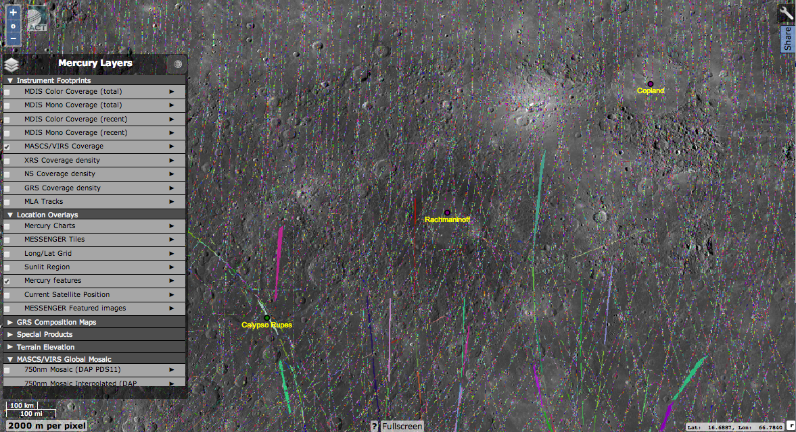
Regional II
VIRS Footprint map

Slide 12
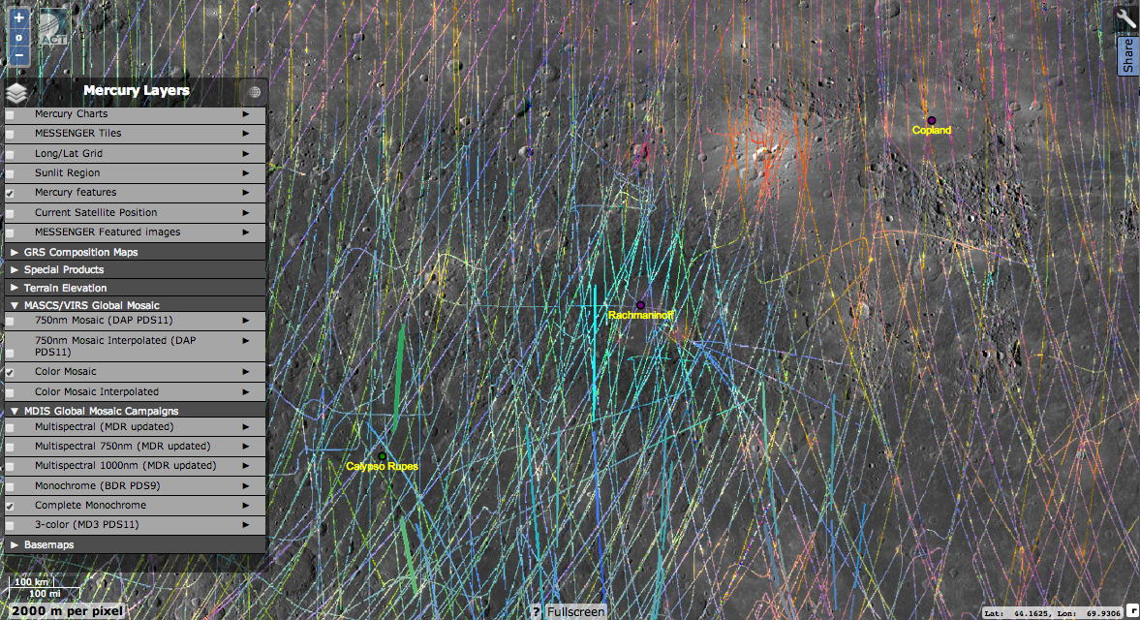
Regional III
VIRS Color Mosaic

Slide 13
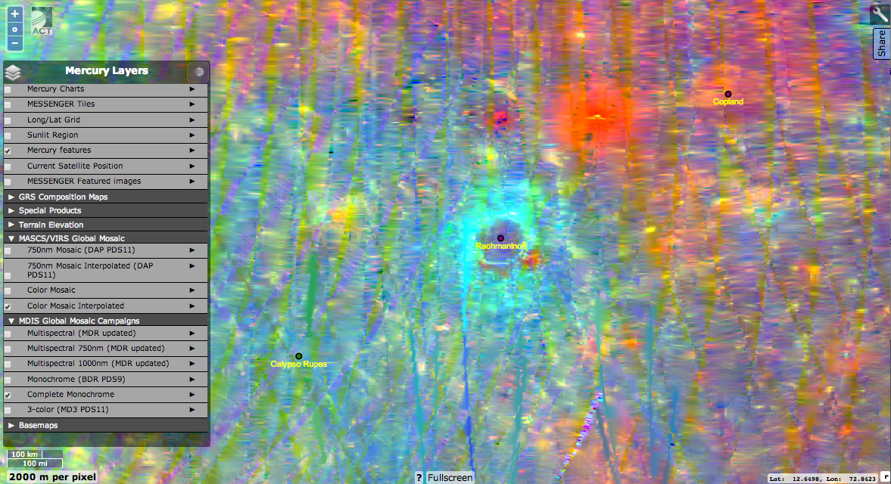
Regional IV
VIRS Interpolated Color Mosaic

Slide 14
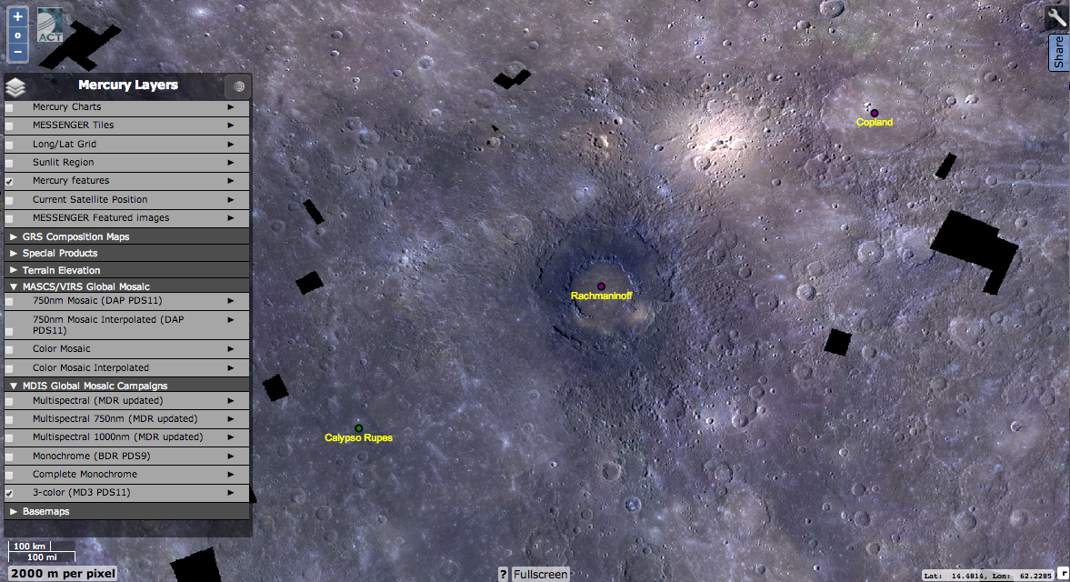
Regional V
MDIS Color Mosaic

Slide 15
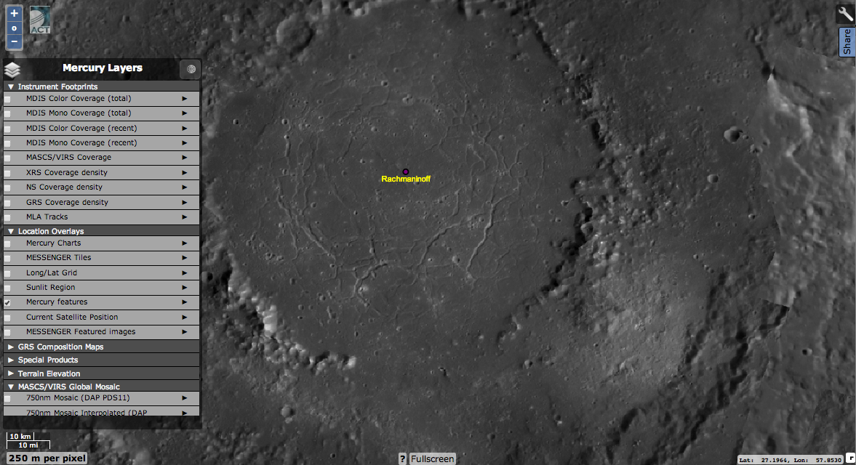
Local I
MDIS basemap

Slide 16
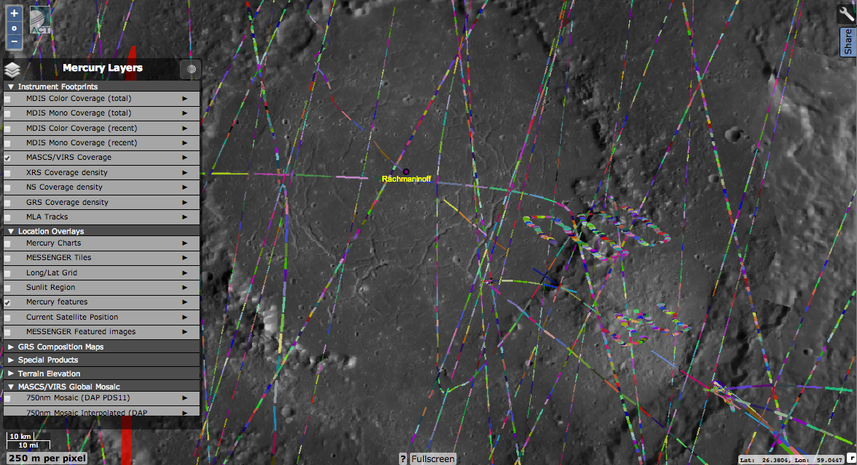
Local II
VIRS Footprint map

Slide 17
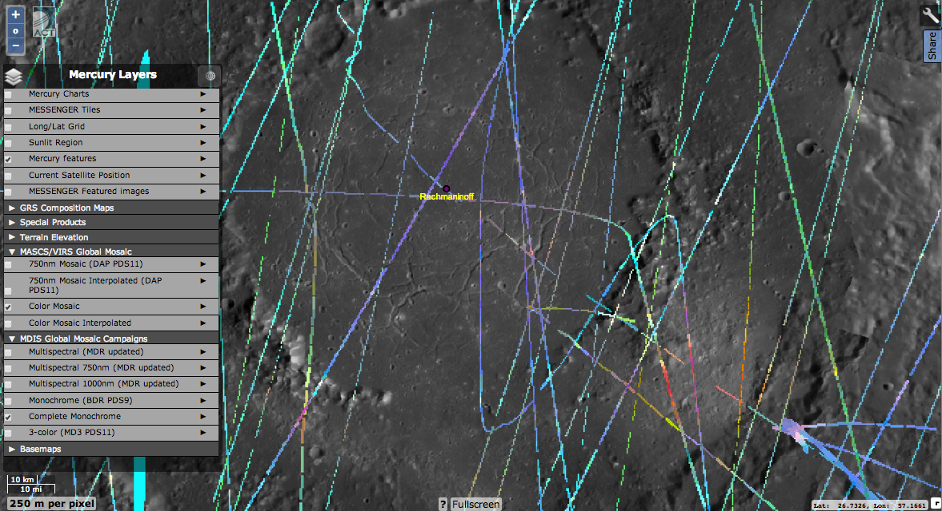
Local III
VIRS Color Mosaic

Slide 18
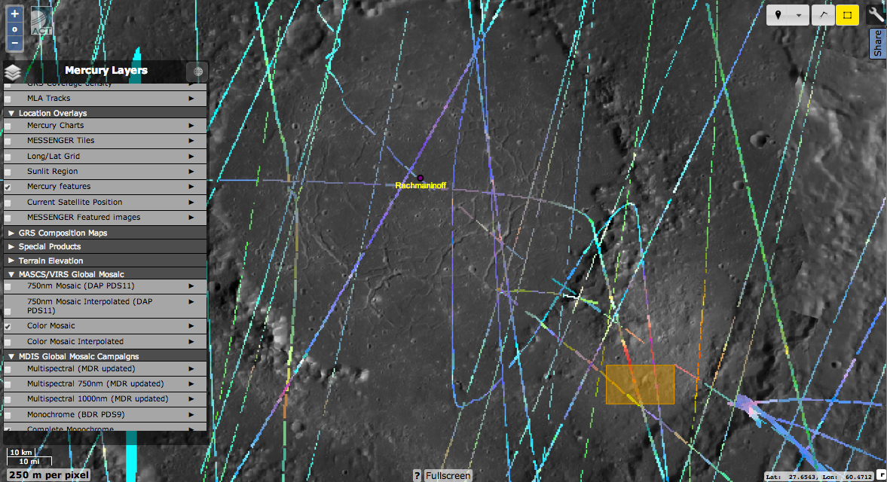
Local IV
Region of Interest

Slide 19
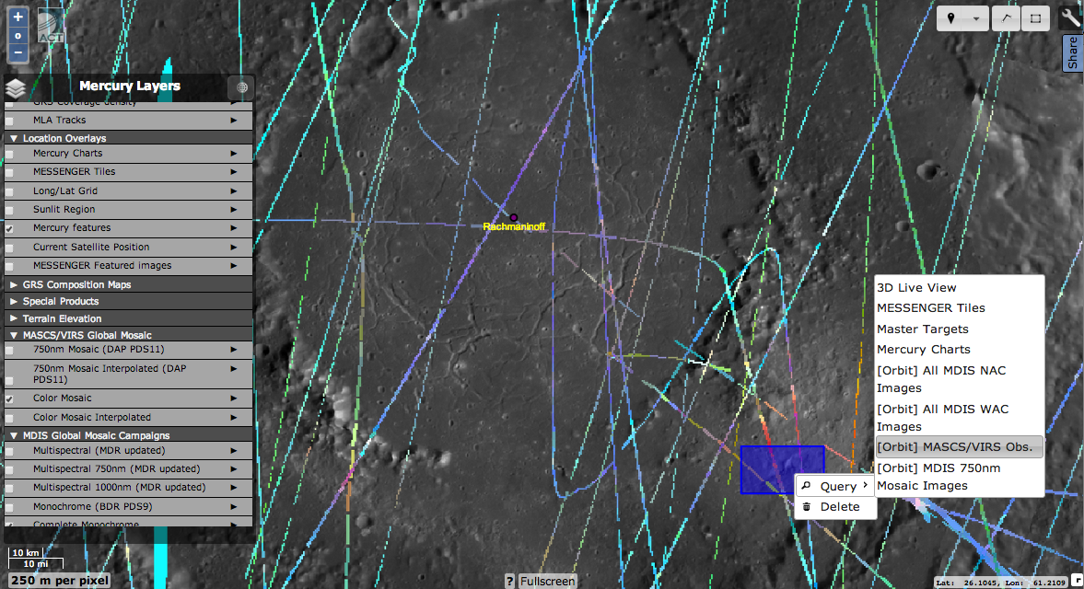
Local V
Region of Interest

Slide 20
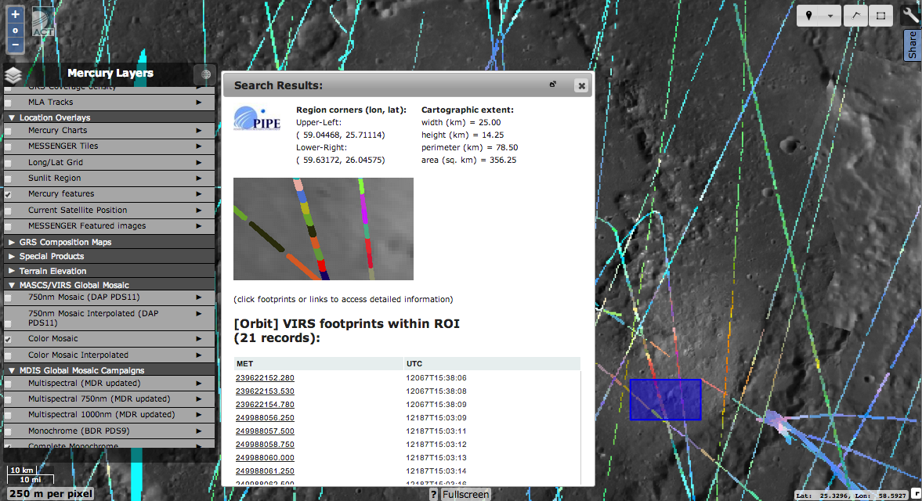
Local VI
Individual Spectra

Slide 21
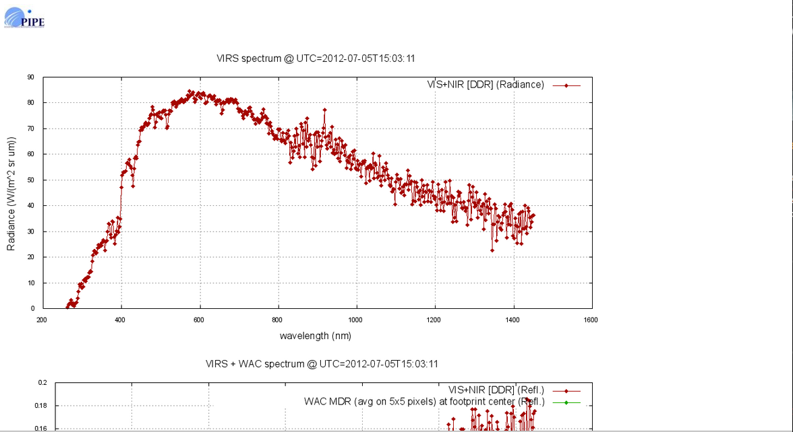
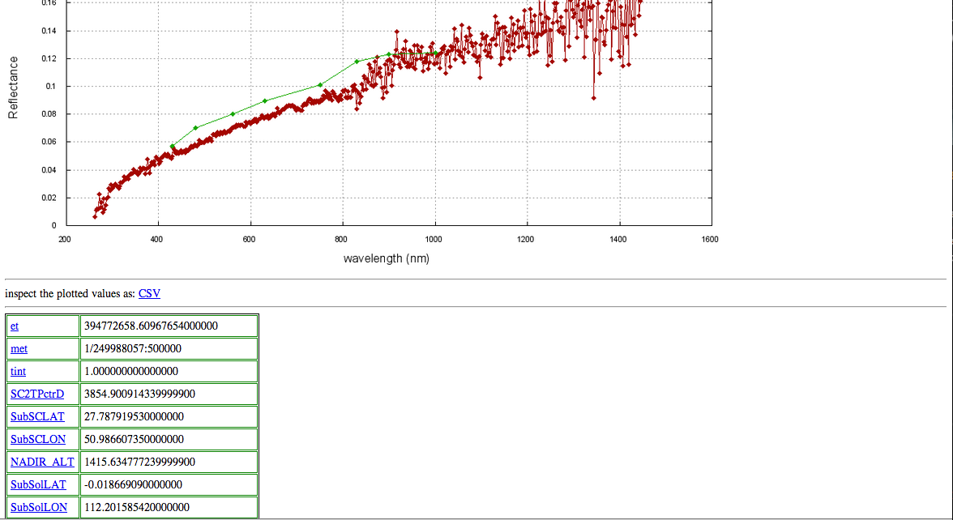
Local VII
Individual Spectra view
Radiance, reflectance plots
DDR/CDR source
CSV Downlink
Viewing Geometry
Spectrum, time
CDR source name
Detector temps

Slide 22
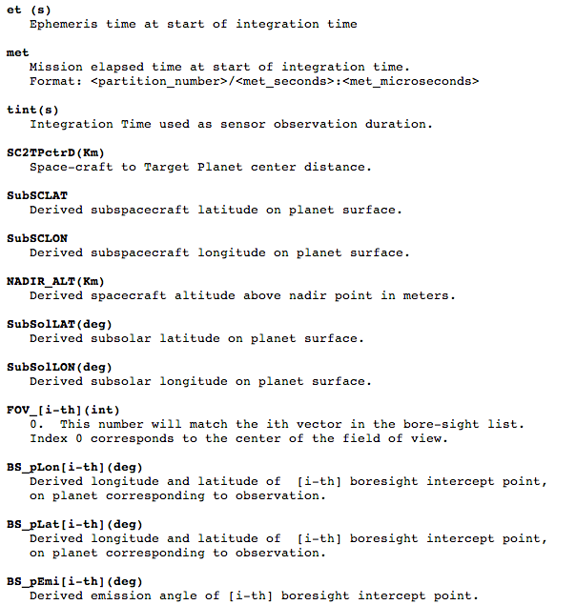
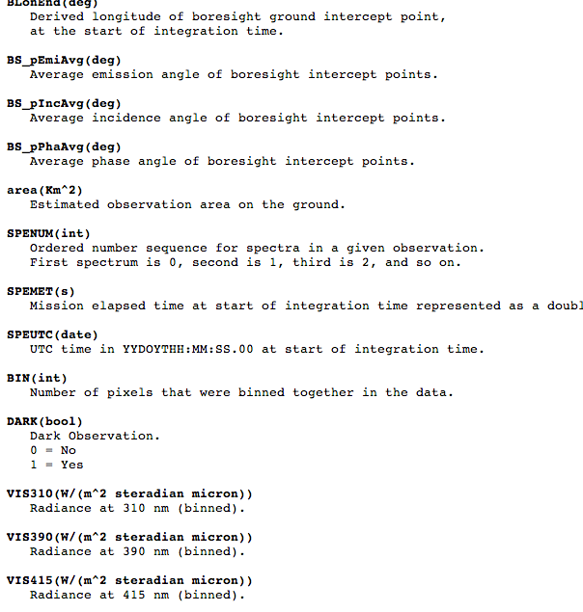
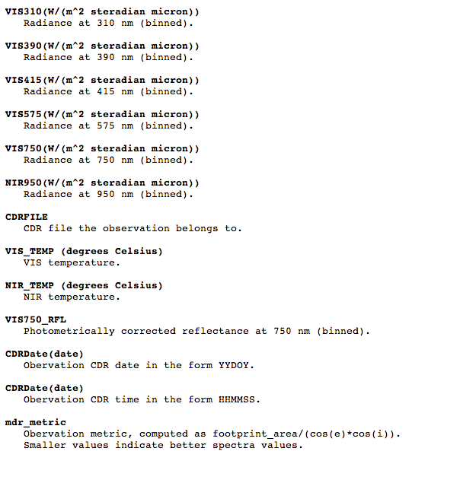
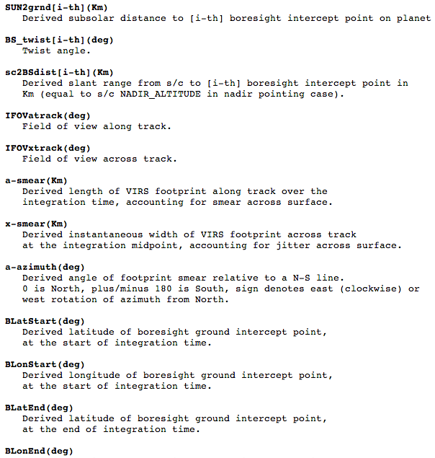
Local VIII
Linked parameter descriptions

Slide 23
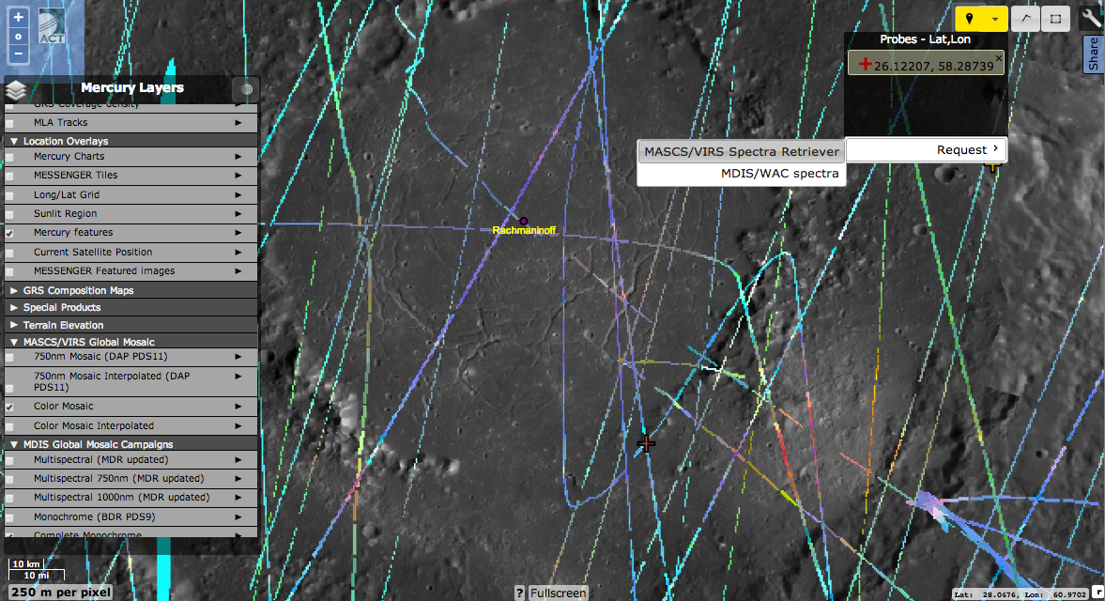
Local IX
QuickSpectra-Retriever

Slide 24
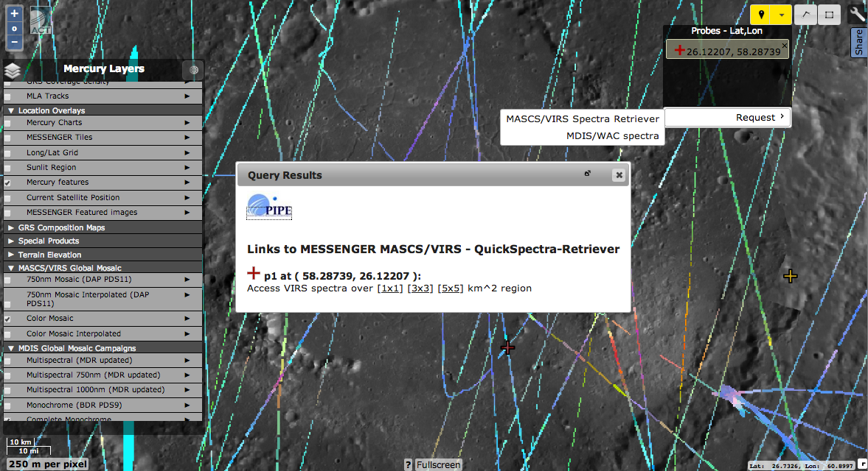
Local X
QuickSpectra-Retriever

Slide 25
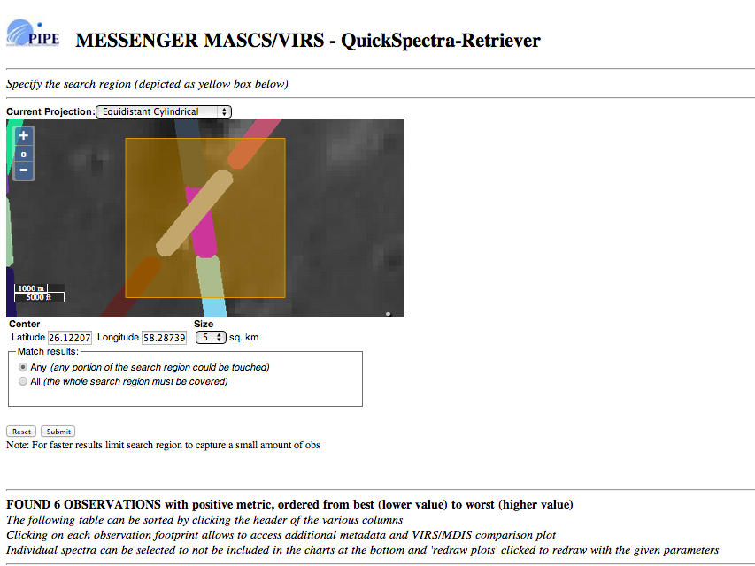
Local VI
Individual Spectra

Slide 26
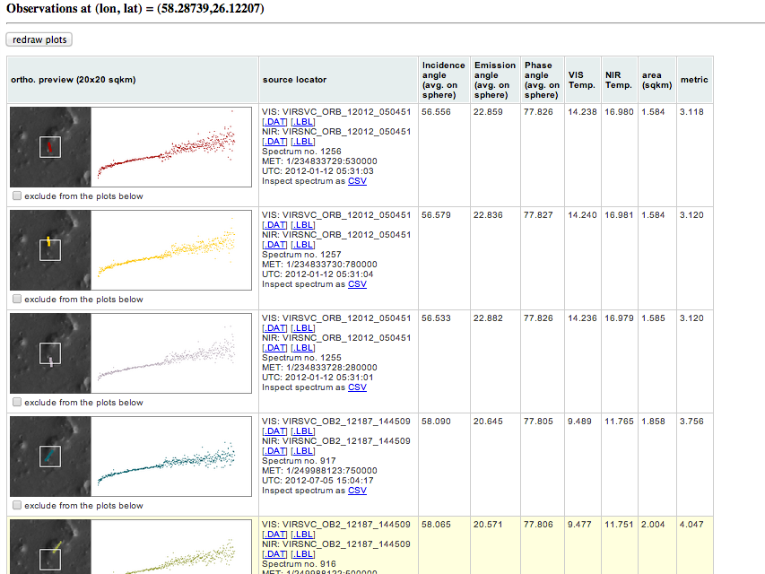
Local VI
Individual Spectra

Slide 27
Local VI
Individual Spectra

Slide 28
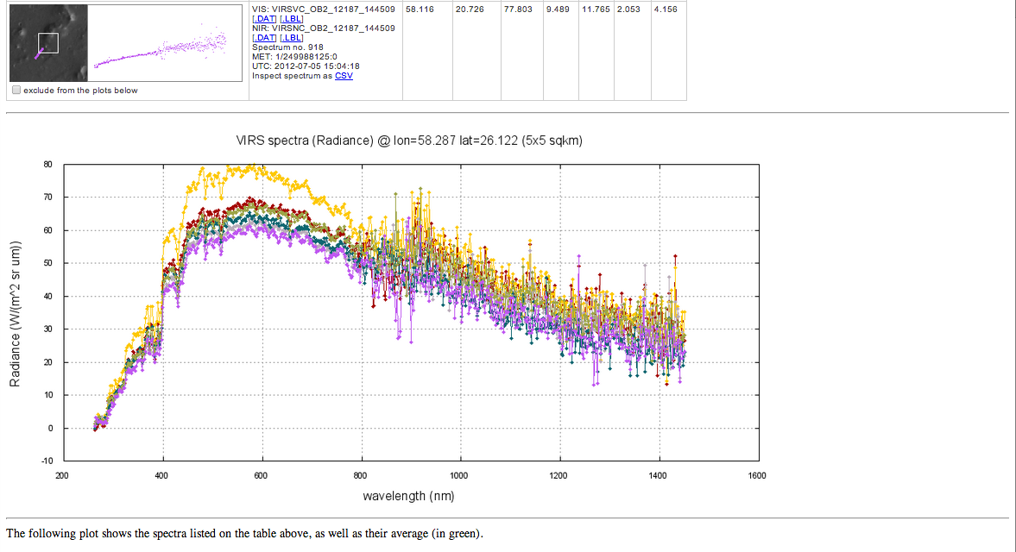
Local VI
Individual Spectra

Slide 29
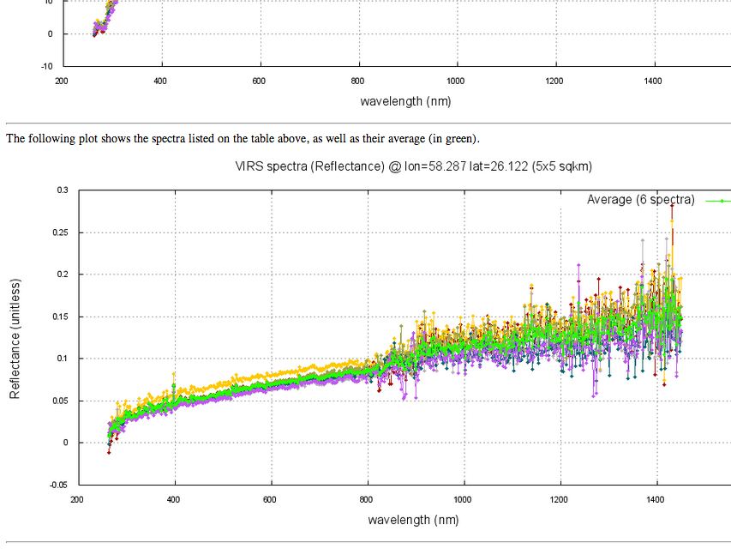
Local VI
Individual Spectra

Slide 30
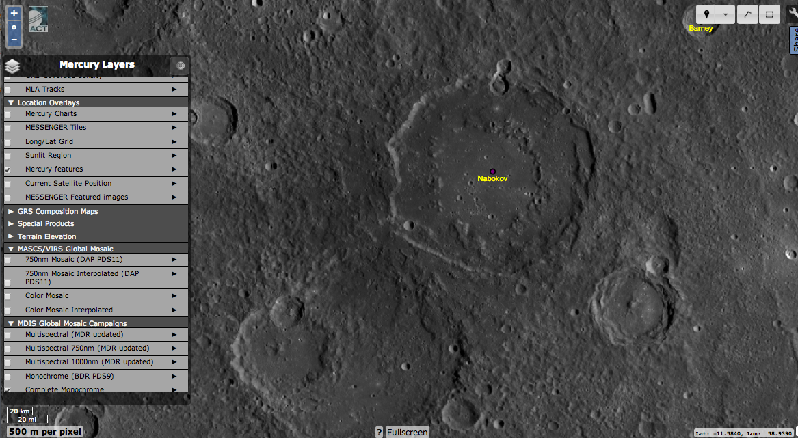
Nabokov Example I
MDIS basemap

Slide 31
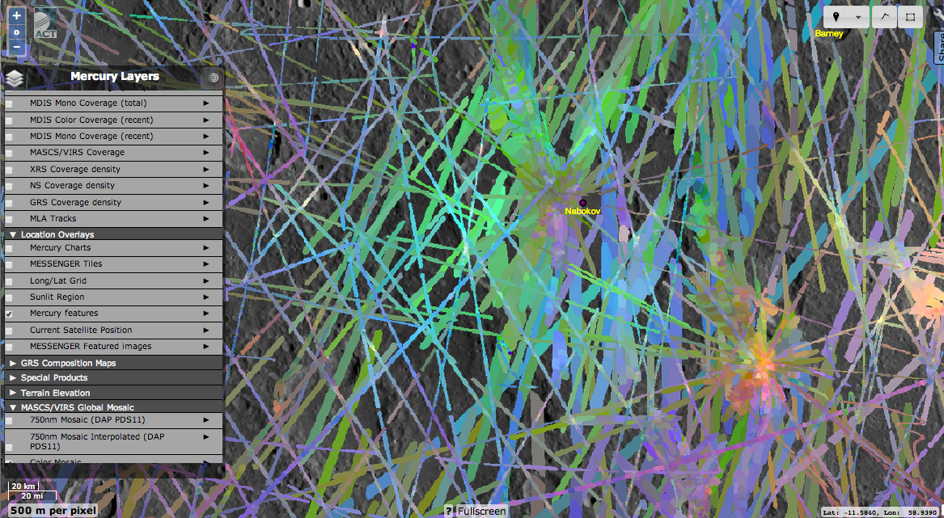
Nabokov Example II
VIRS Color – crowded with many spectra, hard to select one with accuracy. Use QuickSpectra

Slide 32
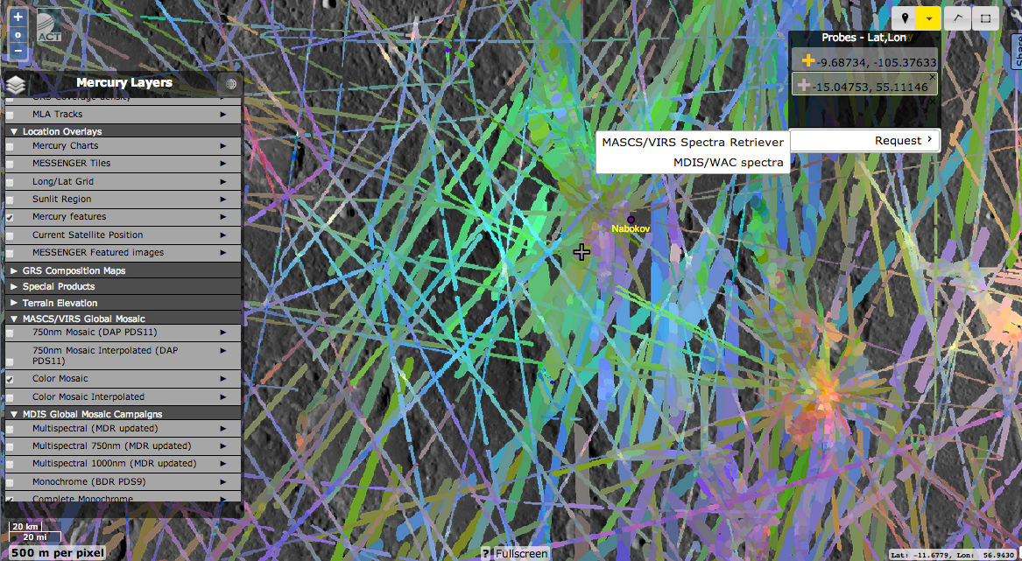
Nabokov Example III
Probe spot and select small area (1x1 km)

Slide 33
Nabokov Example IV
Area filled with footprints, not all of high value

Slide 34
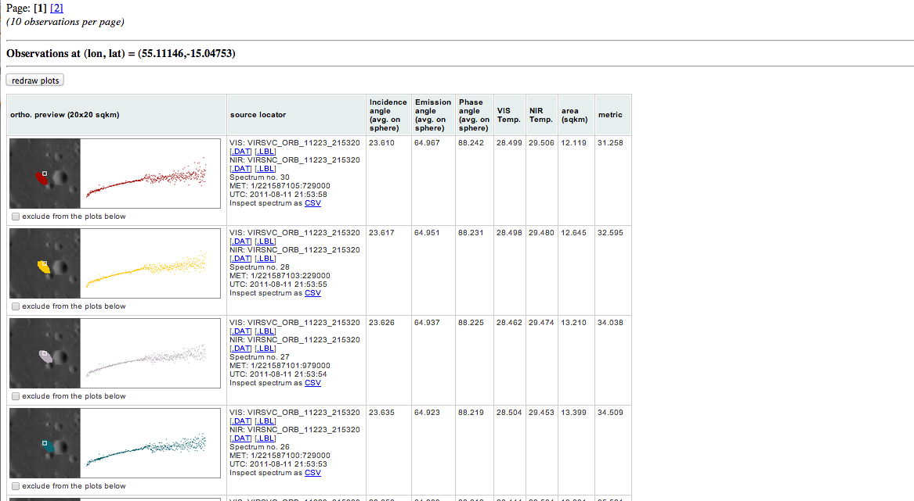
Nabokov Example V
Individual spectra that touch target area

Slide 35
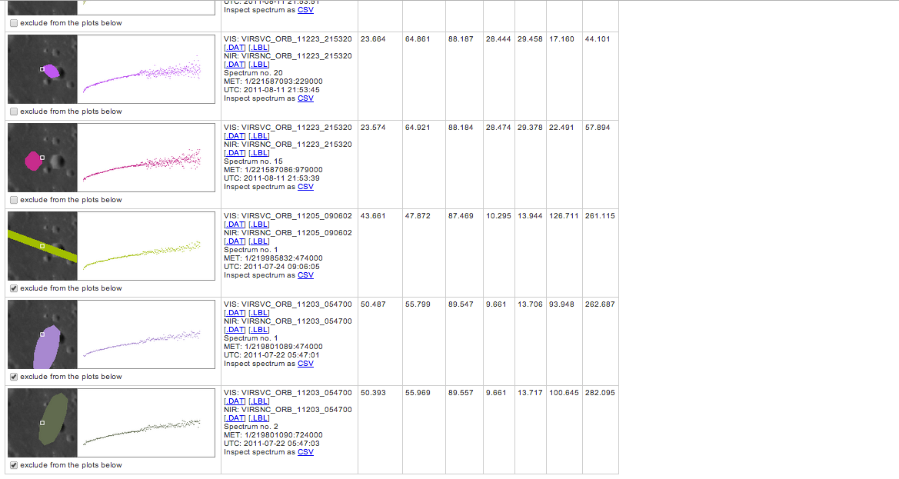
Nabokov Example VI
Excluding footprints you don’t want from average

Slide 36
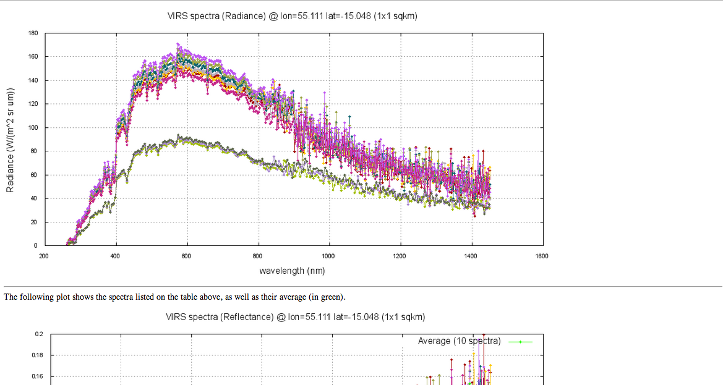
Nabokov Example VII
Radiance

Slide 37
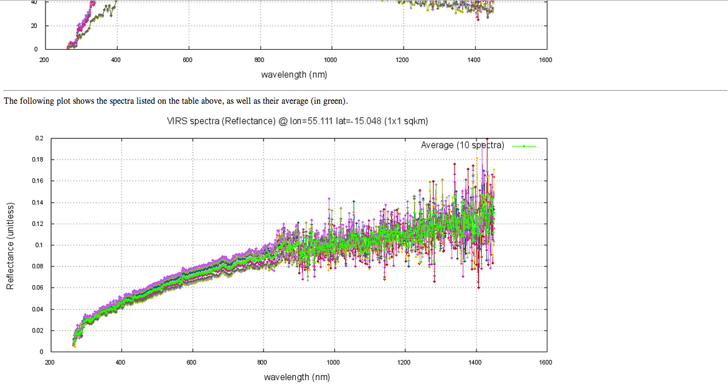
Nabokov Example VIII
Shows only selected spectra and their average.

Slide 38
Do Science With VIRS!
Planned, not yet implemented:
ROI multiple spectrum downloading (currently all bulk data access is via PDS)
Questions, feedback
Contact
noam.izenberg@jhuapl.edu
rachel.klima@jhuapl.edu
Key References:
McClintock and Lankton (2007) Space Science Reviews 131, 481-521
McClintock et al. (2008) Science 321, 62-65
Holsclaw et al. (2010) Icarus 209, 179-194
Izenberg et al. (2014) Icarus 228, 364-374
Klima et al. (2014) LPSC 45 #1978 on Thursday, March 20

