Slide 1
MASCS Instrument &
VIRS Calibration
Rachel Klima (on behalf of the MASCS team)
JHU/APL
MASCS/VIRS Data Users’ Workshop
LPSC 2014, The Woodlands, TX
March 17,2014

Slide 2
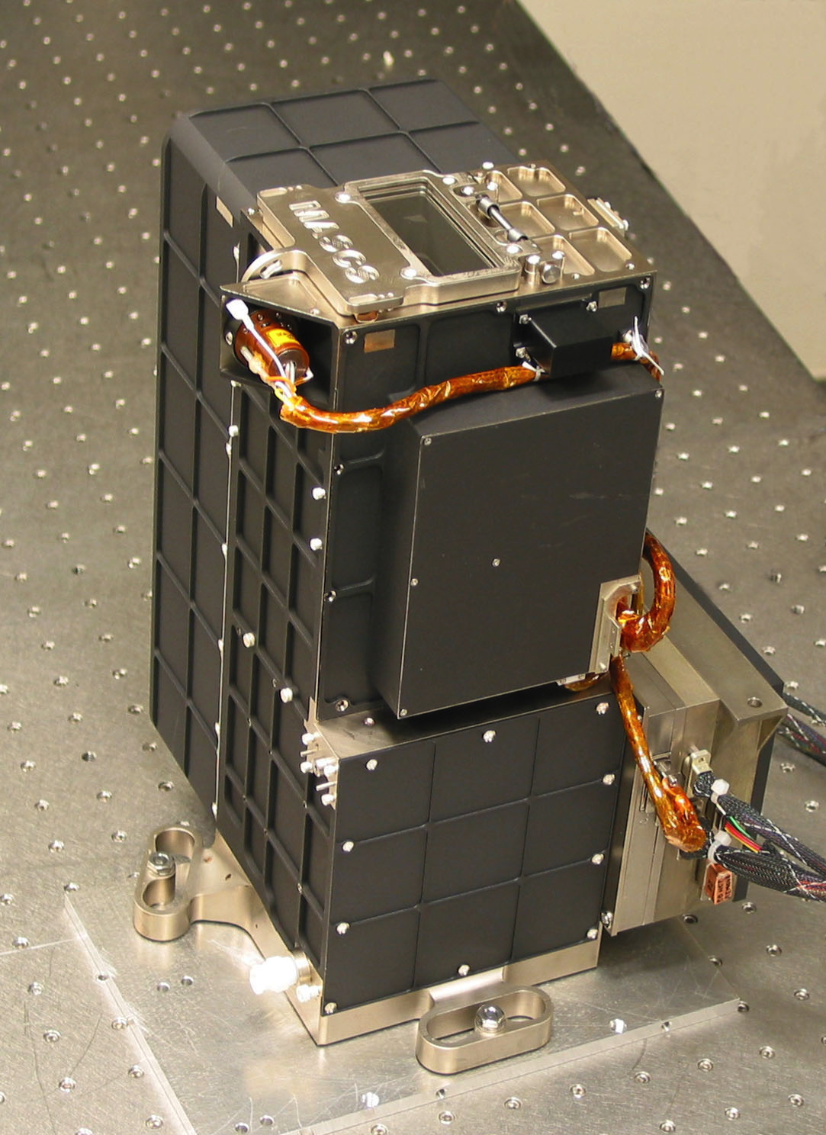
Mercury Atmospheric and Surface Composition Spectrometer (MASCS)
The Ultraviolet and Visible Spectrometer (UVVS)
  115-600 nm (split into FUV, MUV, Vis)
  Primarily designed for exosphere measurements
  Some surface scans being conducted
  Surface data still being validated for science quality
Visible and Infrared Spectrograph (VIRS)
  Surface measurements (300-1450 nm)

Slide 3
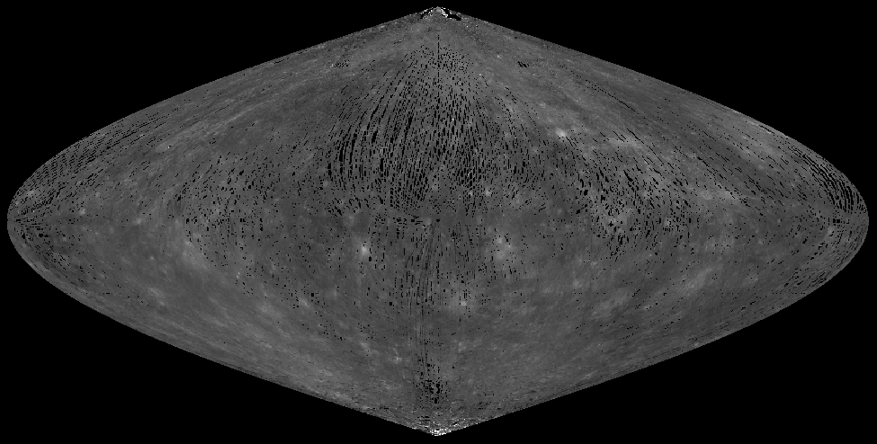
VIRS Observations
Since entering orbit in March 2011, >10 million spectra have been collected (~95% surface coverage at 20 km spacing between footprints)
Observation geometry is heavily restricted by spacecraft operational requirements. Global data at latitudes below 70°N and S are limited to incidence <70°, emission <85°, Phase ranges from 78-102°

Slide 4
VIRS Instrument Design
Cassegrain Telescope (feeds both VIRS and UVVS)
VIS detector: linear 512 element Si array
  300-900 nm
  5 nm spectral resolution
IR detector: linear 256 element InGaAs array
  900-1450 nm
  5 nm spectral resolution
No active detector cooling
Shutter on VIRS entrance assembly
Figures from McClintock and Lankton, 2007, SSR

Slide 5
Nominal VIRS Calibration (to CDR)
Raw DN converted to corrected counts in DN.
Shuttered dark measurements are interleaved with observations to monitor changes in dark current with temperature or other external conditions. A polynomial is fit to the shuttered darks in each data record to interpolate the dark level at the time of each observation.
Corrected counts are converted to radiance.
Noise spectrum – predicted standard deviation of observation based on dark measurements as a function of temperature (noise is in DN)
L = radiance at the sensor
C = raw data value in DN,
B_{e} = background due to an electronic offset (in DN)
B_{d} = dark level (in DN)
B_{g} = grating-scattered light (in DN)
t = integration time (in s)
S = radiometric sensitivity measured in the laboratory in units of DN s⁻¹(W m⁻² sr⁻¹ μm⁻¹)⁻¹

Slide 6
Nominal VIRS Data Calibration (to DDR)
L = radiance at the sensor (W m⁻² sr⁻¹ μm⁻¹)
E_{Sun} = Solar spectrum irradiance (W m⁻² μm⁻¹)
f = dependence of reflectance on viewing geometry
i = incidence angle
e = emission angle
α = phase angle
p(α) = phase function
a₀ = 0.0576
a₁ = -3.52 x 10⁻⁴
r’ = normalized reflectance
Radiance divided by solar spectrum to get radiance factor
Corrected for viewing geometry and phase dependence
Noise spectrum converted to reflectance units

Slide 7
High Temperature Issues
Temperatures were predicted to remain under ~30°C. Data calibration was anticipated to be more challenging at >10°C
Actual temperatures have exceeded 10°C for most of the orbital data. The bulk of data have been obtained at 10-35°C, but some reach >50°C

Slide 8
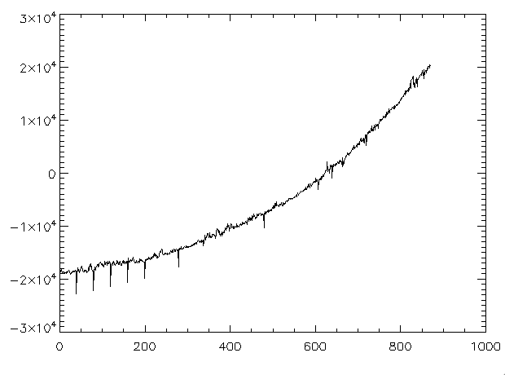
High Temperature Issues
NIR (InGaAs)
Saturation and increased noise in NIR
  Some pixels more sensitive to thermal noise than others
‘Sticking’ of the shutter mechanism (affects both VIS and NIR)
  ‘Dark’ observations used to perform background subtraction are actually light, resulting in the radiance being excessively low or total dark subtraction failure
(for more info, see Klima et al., LPSC 2014, #1978, Thursday Posters)
Vis (Si)
Missing Darks = Shutter Stuck Open
Raw Counts (DN)
Wavelength (nm)

Slide 9
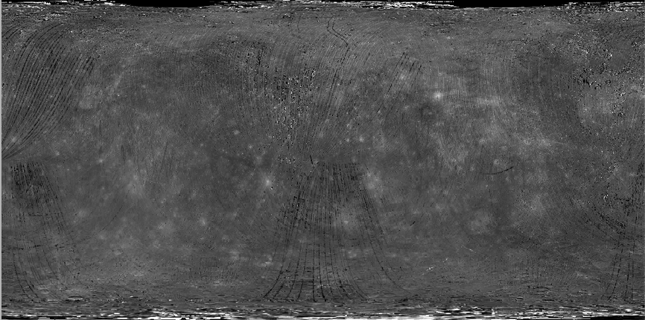
High Temperature Issues
Vis (Si)
Missing Darks = Shutter Stuck Open
Raw Counts (DN)
Wavelength (nm)

