Slide 1
How To Get MESSENGER MASCS VIRS Data from the Planetary Data System
PDS Geosciences Node
For the MASCS VIRS Workshop
Lunar and Planetary Science Conference, March 2014

Slide 2
PDS Geosciences Node: pds-geosciences.wustl.edu
Click Mercury to go to the MESSENGER page.

Slide 3
Click MASCS Archive.

Slide 4
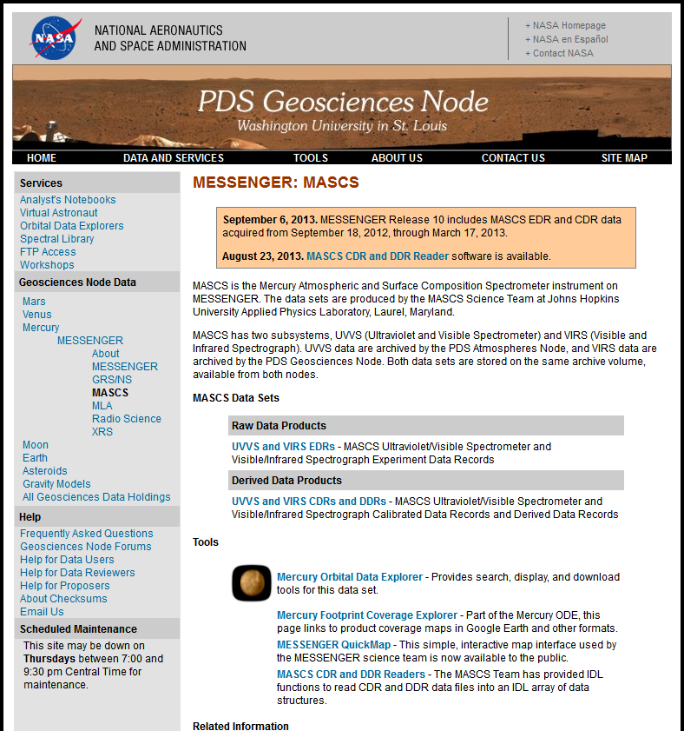
Two ways to find MASCS data:
Follow links directly to raw and derived archives online.
Use the Mercury Orbital Data Explorer search tools to select data products.

Slide 5
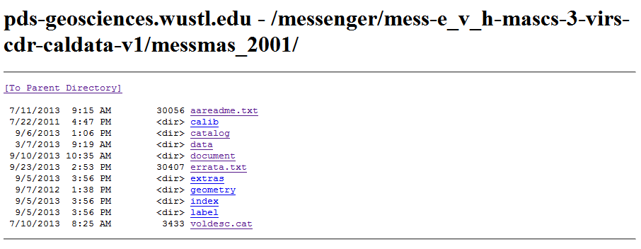
Method A: Direct links to data online
The MASCS derived data archive is in volume messmas_2001.
Data products are in the data directory. Click down the data directory tree to choose product type, mission phase, VIRS data, observation date, and sensor.

Slide 6
Method A: Direct links to data online, continued
Every data file (.dat) comes with a PDS label (.lbl) that describes it. You’ll need both files. Right-click to download.
If you want more than just a few files, it will be easier to get them with FTP. You can use any FTP client. We recommend Filezilla (filezilla-project.org) because it allows easy drag-and-drop downloading. See next page for an example …

Slide 7
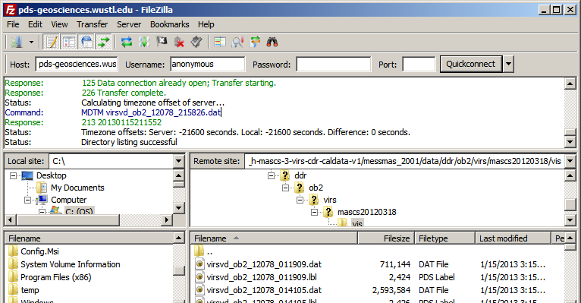
Method A: Direct links to data online, continued
ftp://
To get the FTP address, put ftp:// in front of the link in your browser window, and use that link in your FTP software.
This example uses Filezilla FTP software.

Slide 8
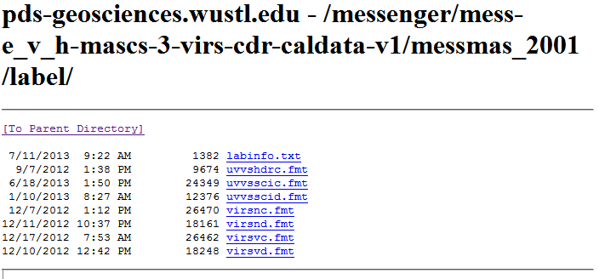
Other files you might need
Look inside the PDS label. There may be a line like ^STRUCTURE = “VIRSVD.FMT”.
Structure files describe the format of the data table. You’ll find them in the LABEL directory of the archive.

Slide 9
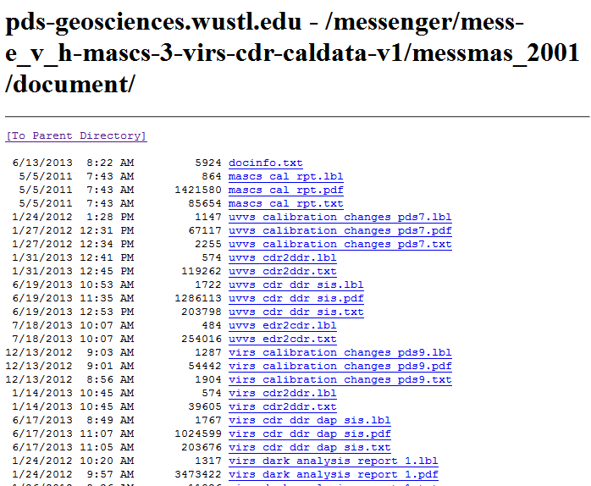
Other files you might need
Documentation is found in the DOCUMENT directory. Each document comes in a PDF version and a plain text version, with a label that describes both. The SIS (Software Interface Specification) is the primary document.

Slide 10
Now for Method B, using the Mercury Orbital Data Explorer.
Two ways to find MASCS data:
Follow links directly to raw and derived archives online.
Use the Mercury Orbital Data Explorer search tools to select data products.

Slide 11
Method B: Using the Mercury Orbital Data Explorer
Choose Data Product Search.

Slide 12
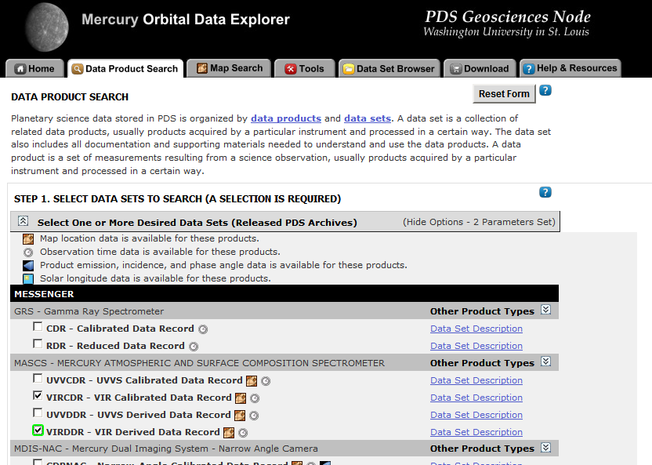
Method B: Using the Mercury Orbital Data Explorer, continued
Open the Select Data Sets pulldown.
Click the checkboxes next to MASCS VIRS data sets.

Slide 13
Method B: Using the Mercury Orbital Data Explorer, continued
Further down the page, enter your desired search criteria.
For example, to search a specific area, first open Find by Product Location, and then enter latitude-longitude limits.
When ready, choose View Results in Table.

Slide 14
Method B: Using the Mercury Orbital Data Explorer, continued
Click a Product ID to see more information on the right side of the screen
Check the products to be downloaded
Click Update Cart to add checked products to your shopping cart
When ready, click Download.

Slide 15
Method B: Using the Mercury Orbital Data Explorer, continued
Open View Products Selected for Download to see what’s in the shopping cart.
Check one of the Download Options to include additional files in the cart.
When ready, click
at the bottom of the page.

Slide 16
Method B: Using the Mercury Orbital Data Explorer, continued
Enter your email address to be notified when your order is ready to download.
Then click Submit Request.

Slide 17
Other Useful Tools
Mercury Footprint Coverage Explorer shows product coverage maps in various formats.
MESSENGER Quickmap allows map-based searches and downloads.
MASCS CDR and DDR Readers help read data into IDL.

Slide 18
For More Information
Visit the PDS Geosciences Node booth at LPSC to talk with PDS representatives and get a hands-on demonstration.
Questions after LPSC? Try the Geosciences Node Forums for data users and data providers, at http://geoweb.rsl.wustl.edu/community/.
If you can’t find the answer on the forums, send an email to geosci@wunder.wustl.edu.

