Slide 1
MASCS/VIRS Data Record Structure What are EDRs, CDRs, and DDRs?
Rachel Klima (on behalf of the MASCS team)
JHU/APL
MASCS/VIRS Data Users’ Workshop
LPSC 2014, The Woodlands, TX
March 17,2014

Slide 2
Experiment Data Records (EDRs)
Experiment Data Records contain the raw data and spectrum metadata.
Important information for filtering or checking the quality of the data, including the raw spectrum data is passed through to Calibrated Data Records (CDR) and also available there.
Fields and number of bytes allocated to each field are described in the CDR/DDR SIS available here: http://pds-geosciences.wustl.edu/messenger/mess-e_v_h-mascs-3-virs-cdr-caldata-v1/messmas_2001/document/virs_cdr_ddr_sis.pdf
Important metadata includes: Dark Frequency, instrument temperature, integration time, gain, lamp on, binning, start and end pixel, spectrum number, spectrum mission elapsed time (MET). All of these are passed through to the CDRs.

Slide 3
Calibrated Data Records (CDRs)
Calibrated Data Records contain instrument status information necessary to filter and validate data quality
UTC time translated from spacecraft time
Spectra included (one row per spectrum):
Raw Spectrum – direct from EDR, uncompressed raw spectrum as 16-bit DN.
Corrected Counts – corrected for dark current and other instrument level corrections (DN/sec)
Calibrated Radiance – derived radiance at sensor (W m⁻² sr⁻¹ μm⁻¹).
Noise Spectrum – estimated noise (in DN) based on noise measured during shuttered darks as a function of temperature plus shot noise.
Channel Wavelengths – wavelengths for each detector element
Spice derived geometry information (lat, lon, viewing geometry, slant range, subspacecraft lat/lon, footprint size, etc.)
Data Quality Index (described on next slide)

Slide 4
Data Quality Index (in CDRs and DDRs)
19 character index of data quality. Each digit signifies quality factor of measurements.
Format: ABCD-EFGH-IJKL-MNOP
A: Dark Scan Flag, denotes shutter commanded closed for dark observation: 0 = shutter not engaged; 1 = shutter engaged.
B, C, D: Temperature 1,2, Grating Flags:
0 = Temperature does not exceed 15 deg C threshold
1 = Temperature exceeds 15 deg C threshold but less than 25 deg C threshold.
2 = Temperature exceeds 25 deg C threshold but less than 40 deg C threshold
3 = Temperature exceeds 40 deg C threshold.
E: Anomalous Pixels: Integer 0-9 = Indicates number of hot pixels found (the number of pixels with a noise spike (defined in DQI L, below).
F: Partial Data Flag: 0 = No partial data; 1 = Partial data exists.
G: Saturation Flag: 0 = No pixels saturated; 1 = Saturated pixels exist.
H: Low Signal Level Flag: 0 = Signal level not below -32768 threshold; 1 = Signal level below -32768 threshold.
I: Low VIS Wavelength Uncertainty Flag (not yet implemented, set to 0)
J: High VIS Wavelength Uncertainty Flag (not yet implemented, set to 0)
K: UVVS Operating Flag: 0 = UVVS is not scanning during readout; 1 = UVVS is scanning during readout.
L: UVVS Noise Spike Flag: 0 = No noise spike detected; 1 = Noise spike detected (A noise spike is a data value in 1 or 2 channels that exceeds 3 standard deviations of the average for a given channel in a given observation).
M: SPICE Version Epoch: Indicates what SPICE is used to determine pointing fields in CDR. ‘Predict’ SPICE may change one or more times before settling on ‘Final’ pointing solutions about 2 weeks from data acquisition.
0 = No SPICE
1 = Predict
2 = Actual
N-P: Spares

Slide 5
Derived Data Records (DDRs)
Temperatures, dark frequency, integration time, spacecraft time from EDR; UTC, Data Quality Index, Spice derived geometry from CDR
Spectra included (one row per spectrum):
IoF Spectrum – reflectance at sensor (no correction for viewing geometry)
Photom IoF Spectrum – reflectance at sensor corrected to a viewing geometry of 45,45, 90 (see slide 6 and Izenberg et al., 2014)
IoF Noise Spectrum – noise spectrum propagated through to reflectance units
Photom IoF Noise Spectrum – noise spectrum propagated through to normalized reflectance units
Channel Wavelengths – wavelengths for each detector element

Slide 6
Derived Analysis Products (DAPs)
An image file containing the mosaic of MASCS/VIRS reflectance @750nm,
An image file containing the interpolated mosaic of MASCS/VIRS reflectance @750nm,
An image file containing the incidence angle of MASCS/VIRS observations used in mosaic,
An image file containing the emission angle of MASCS/VIRS observations used in mosaic,
An image file containing the phase angle of MASCS/VIRS observations used in mosaic,
An image file containing the area of MASCS/VIRS observations used in mosaic,
An image file containing the CDR Date of MASCS/VIRS observations used in mosaic,
An image file containing the CDR Time of MASCS/VIRS observations used in mosaic
An image file containing the spectrum number of MASCS/VIRS observations used in mosaic.

Slide 7
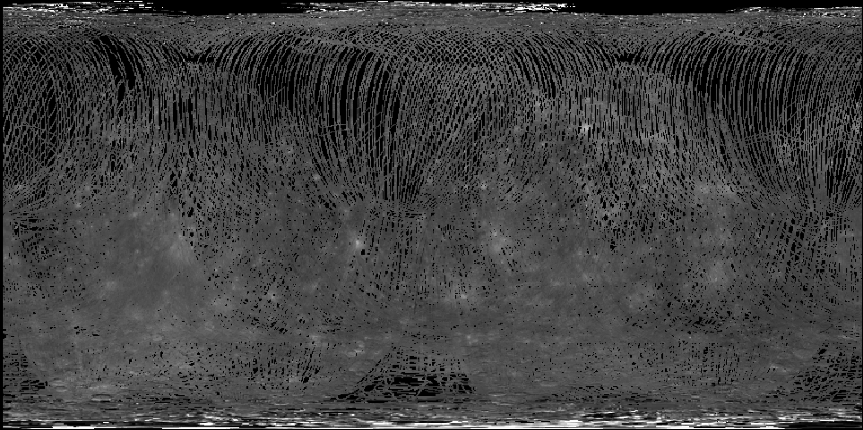
750 nm Reflectance Map

Slide 8
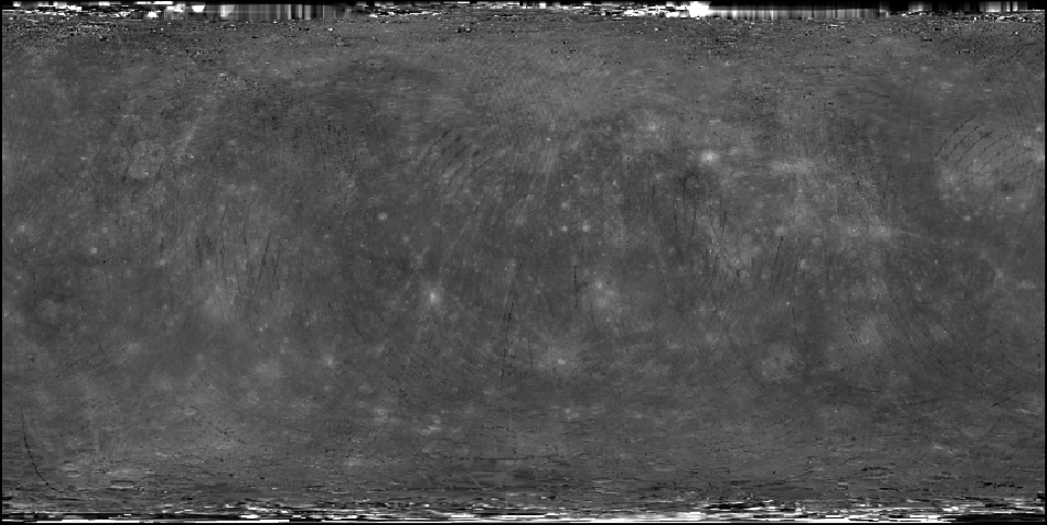
Interpolated 750 nm Reflectance Map

